Slide 1
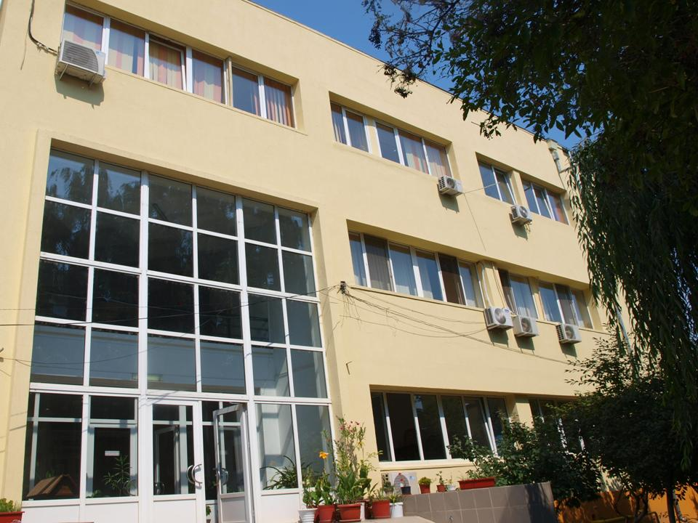

National R&D Institute
for Textiles and Leather
Division:
Leather & Footwear
Research Institute

Slide 2
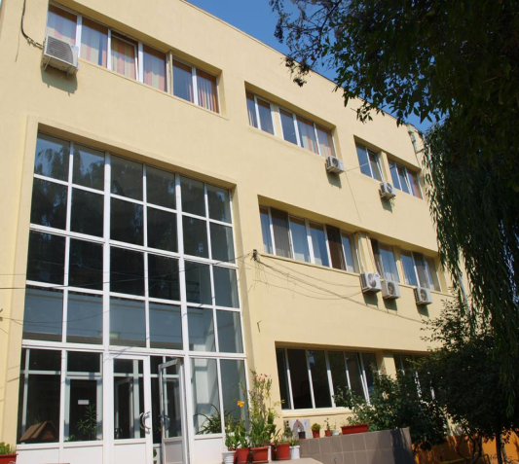

GENERAL DATA
The National Research & Development Institute for Textiles and Leather - Division: Leather and Footwear Research Institute
(INCDTP - ICPI)
  Location: 93, Ion Minulescu str., sector 3,
Bucharest, ROMANIA
Core activities: “Research and development in natural
sciences and engineering” (NACE: 7219)
Turnover: 2,93 M Euro / ICPI: 1,48 M Euro (2016)
Employees: 181 / ICPI: 76

Slide 3


OVERVIEW
Leather and Footwear Research Institute (ICPI) is the Division of the National Research and Development Institute for Textiles and Leather (INCDTP) established in Bucharest since 1951;
In Romania ICPI possesses unique expertise and R&D facilities in the field of leather processing, shoe manufacturing and allied fields;
In order to accomplish its active role ICPI collaborates with SMEs, other R&D centers, universities, associations, public bodies etc. from Romania and abroad and is developing the following R&D directions:

Slide 4
R&D DIRECTIONS:
Innovative materials and eco-friendly technologies for leather, rubber and footwear sectors;
Recycling / valorization of wastes in leather and footwear sectors for added value byproducts generation;
Collagen advanced biomaterials and drug delivery systems with applications in medicine, pharmacy and cosmetics;
Medical footwear used in the conservative treatment of the lower limb pathomechanics;
Assessment, conservation and treatment procedures & materials (including leathers and parchments) for evaluation and restoration of collagen based historical & cultural objects;
Training personell for new skills and competences;
Studies and strategies for increasing leather& footwear sectoral competitiveness and RDI capacity;
INCDTP obtained in 2013 the A+ certification level, according to the Gov. Decision 1062/2011.

Slide 5
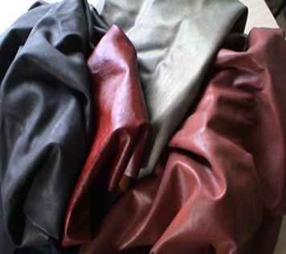
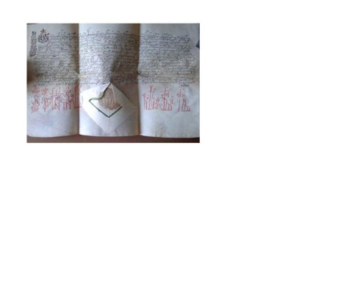
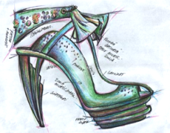
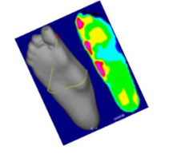
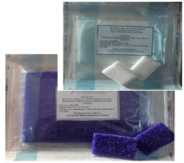
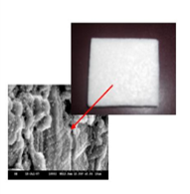
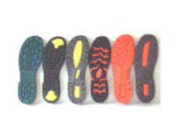
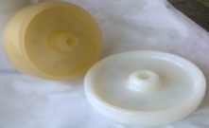
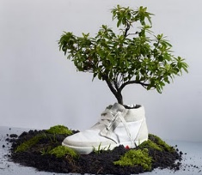


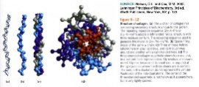
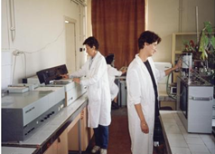
ORGANISATIONAL
STRUCTURE
Department for LEATHER Research
Department for FOOTWEAR Research and DESIGN
Department for COLLAGEN Research
Department for RUBBER Research
Laboratory for TESTS and QUALITY CONTROL
Department for BIOTECHNOLOGIES & ENVIRONMENT PROTECTION Research
COMPARTMENT for INFORMATION DISSEMINATION
                Support services
Department for Experimental Production & Services
ICAMS

Slide 6
HUMAN RESOURCES
ICPI’s total personnel number is 76 of which:
51 R&D personnel - 31 are accredited researchers;
25 doctors and 3 PhD students;
25 Non R&D personnel;
52 women and 24 men.

Slide 7
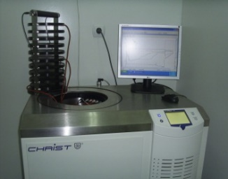
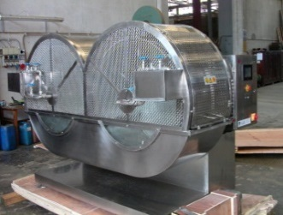
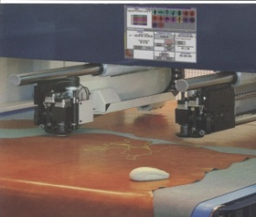
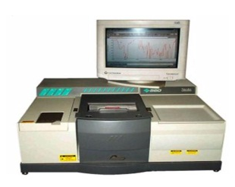
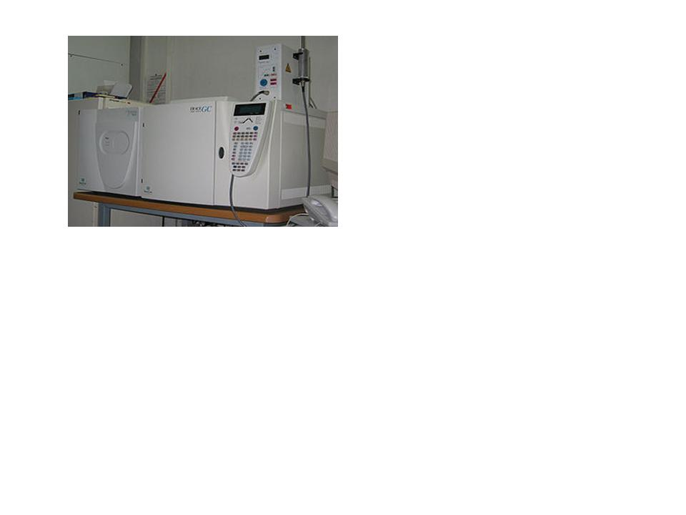
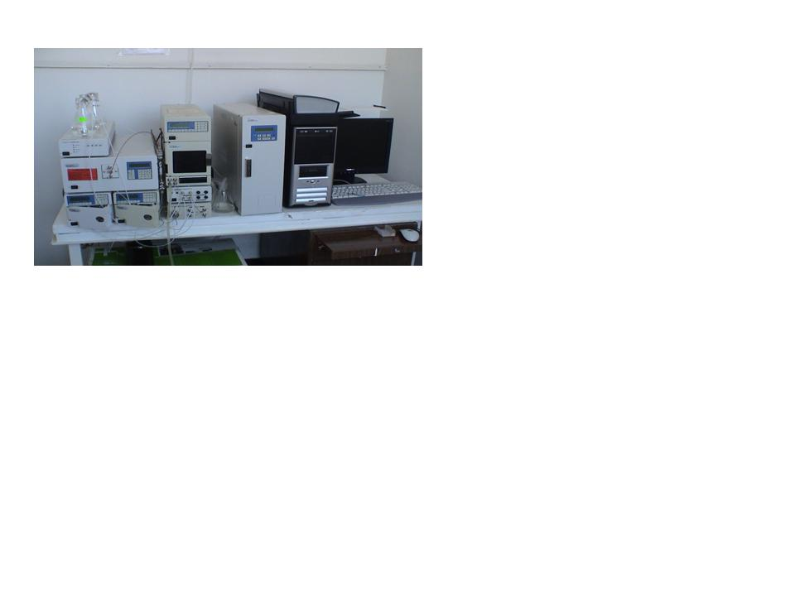
INFRASTRUCTURE
Modern RDI infrastructure - high-tech equipment for instrumental analysis, accredited laboratory, modern pilot stations
Equipment type | Utilisation field | Rate of exploitation [%]
Laboratory equipment | R&D activities Testing services | 70 20 - 22
Technological equipment | - R&D activities - Valorization of R&D results and services | 70 17 - 20

Slide 8


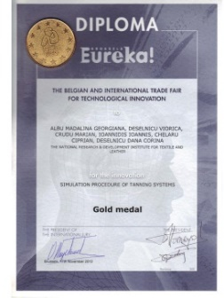
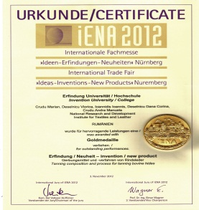

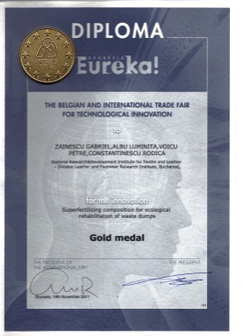
SCIENTIFIC
RESULTS

Slide 9
PROJECTS
INCDTP-ICPI has a portfolio of over 60 international projects (FP5, FP7, EUREKA, EUROSTARS, PHARE, LEONARDO da VINCI, IEE, SEE-ERA.NET PLUS, SIINN-ERA, ERA-RUS+, ERASMUS, BILATERAL COOPERATION);
ICPI participated in ERASMUS Training Program as Host organisation for professors and students from Romania, Turkey, Greece, China, Lithuania.
Projects in the field of Education & Training (selection):
Advanced Technologies and Materials for Conservation and Protection of Cultural Heritage _ LLP;
KNOWLEDGE 4 FOOT - Knowledge Platform for Transferring Research and Innovation in Footwear Manufacturing (K4F) _ ERASMUS+;
Fit to Comfort - Skills Alliance for comfort & healthy footwear manufacturing – new qualification profile and innovative training opportunities (FIT2COM) _ ERASMUS+;
LEAMAN - Manager in an efficient and innovative leather company - ERASMUS+.
INNOLEA - Innovation for the Leather Industry in Jordan and Egypt

Slide 10
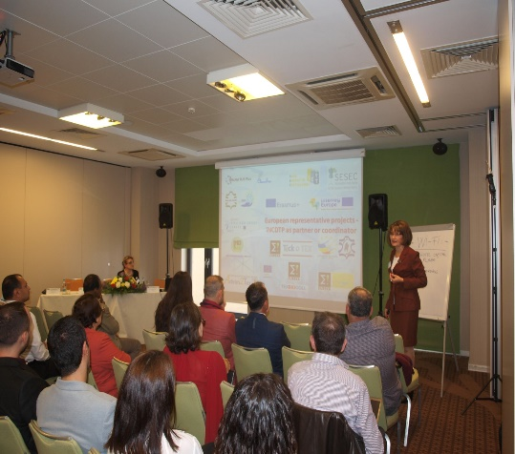
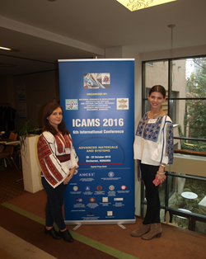
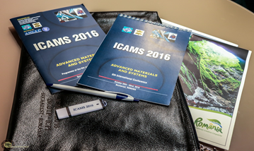
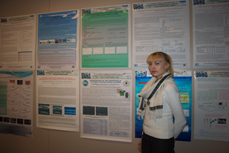
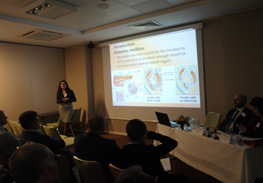
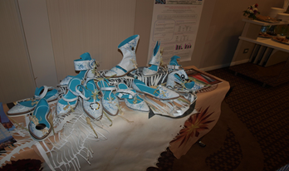
In ICAMS 2016 - 157 participants from 12 countries; 98 scientific papers
NEXT edition - The 7th International Conference on Advanced Materials and Systems ICAMS 2018 - Bucharest, Romania, October 18-20, 2018

Slide 11

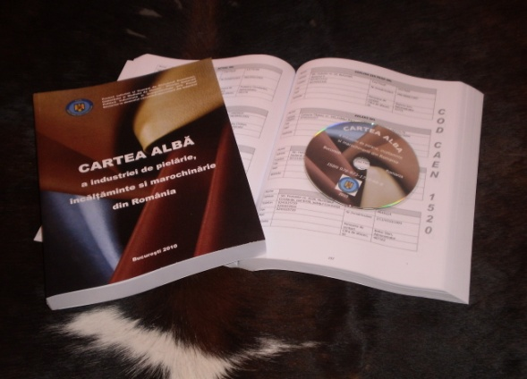
LEARTER AND FOOTWER JOURNAL
ISSN: 1583-4433
Indexed in:
SCOPUS, CROSREF, EBSCO + other 17 databases

Slide 12
THANK YOU FOR YOUR
ATTENTION!

